Slide 1
Golang Introduction

Slide 2
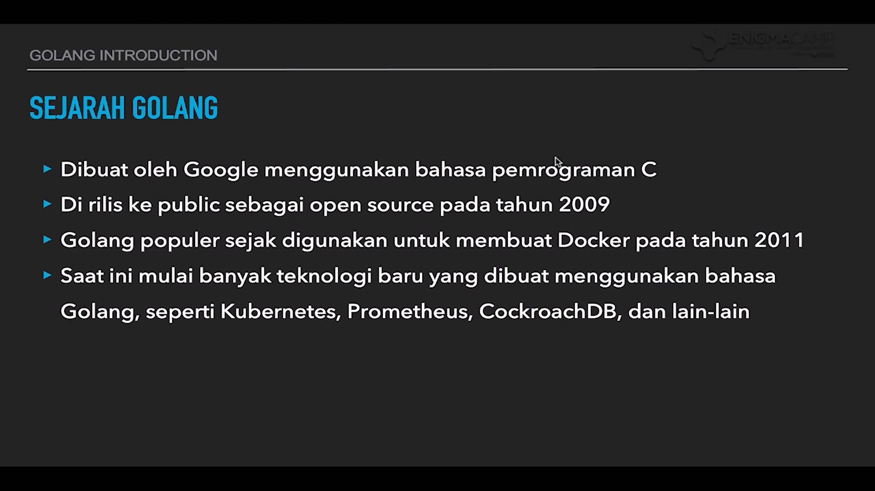

Slide 3
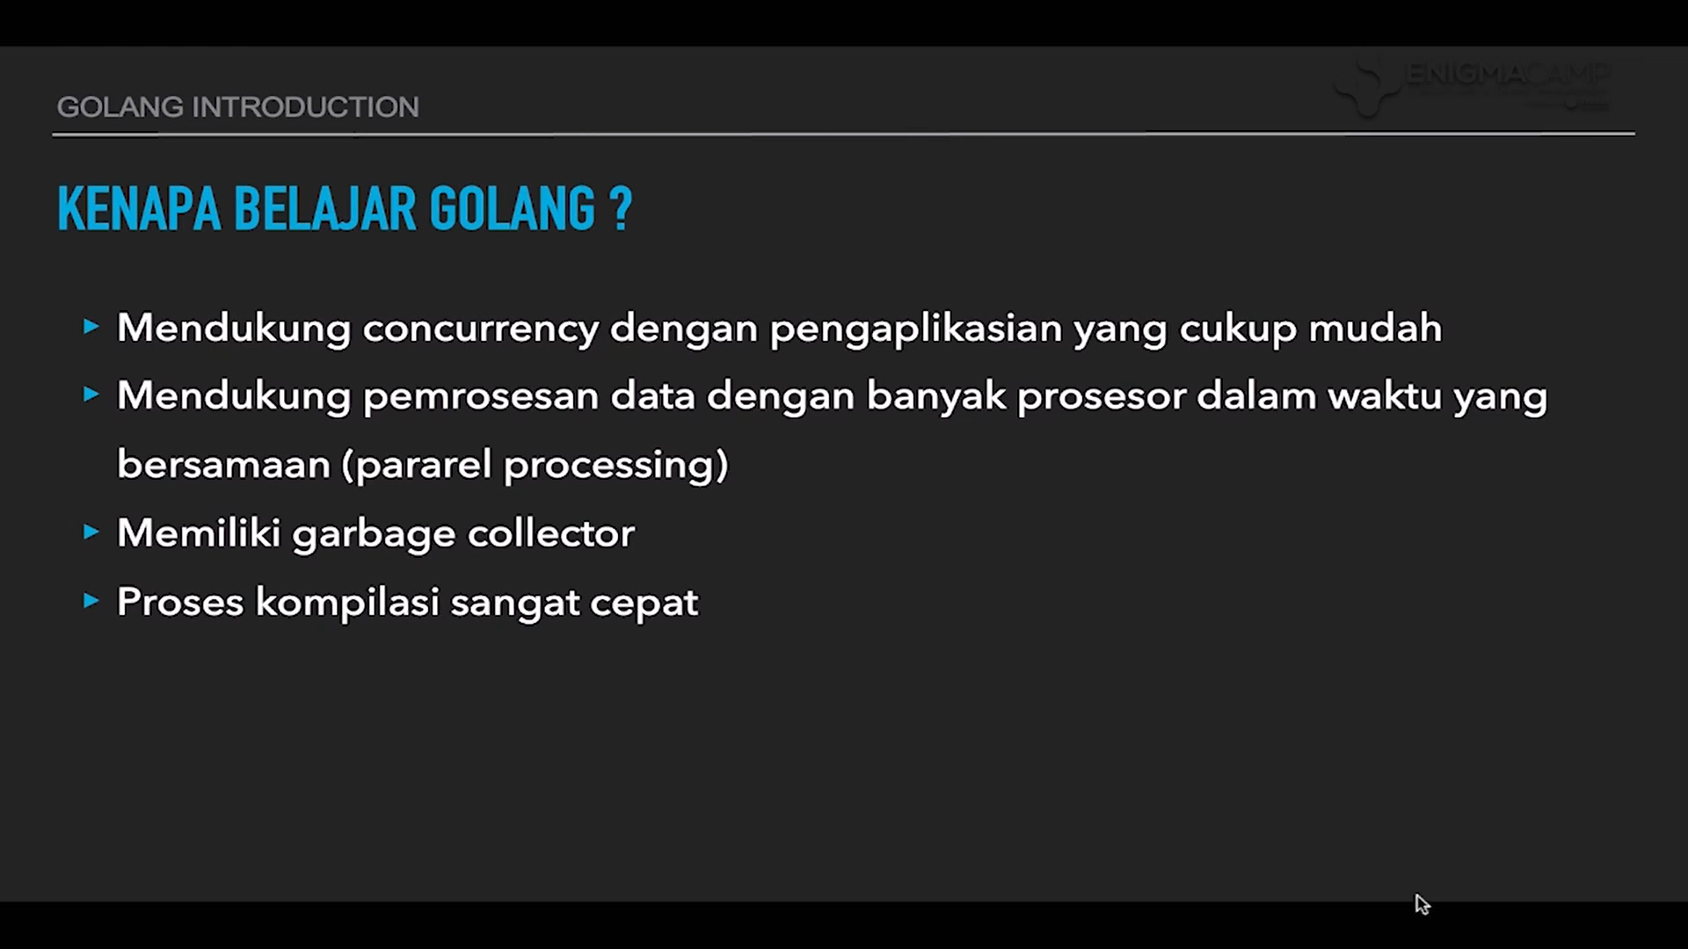

Slide 4
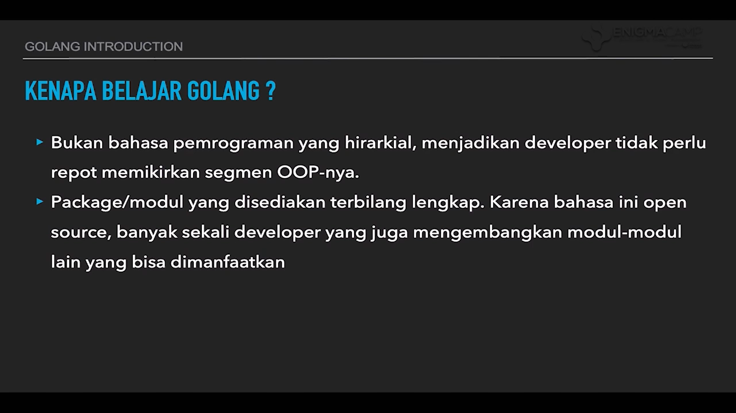

Slide 5
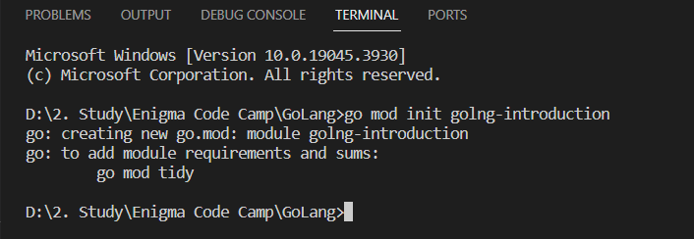
Creating first program with GoLang
To initialize GoLang application we will need to write this code at the CMD
go mod init project-name

Slide 6
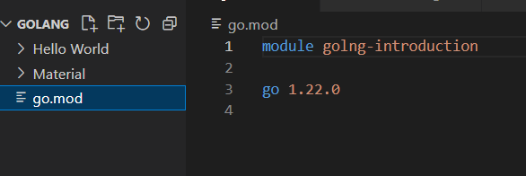
Once you initialize the app, the cmd will create the go.mod file as for the golang app module.
go.mod file in a GoLang project is used to manage dependencies for the project.

Slide 7
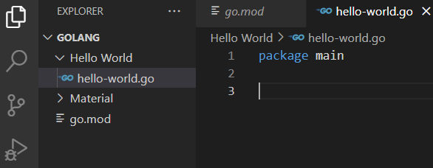
Creating first program with GoLang
Every program file in GoLang require package in this example we can use package called main.
To develop GoLang app we need at least 1 file that contain the package main
package main

Slide 8

Import “fmt” in GoLang
Secondly it’s require to provide import “fmt” at GoLang App.
fmt is a GoLang built in modules that contain several usefull function for the development.
import “fmt”

Slide 9

function main()
Lastly every Go Program require to have function called main()
main() is the first function that will be executed when we start the development.
func main() {
.......
}

Slide 10
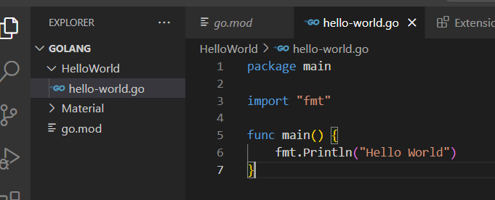
Print hello world
We can use one of the function from “fmt” which called Println to print words to the Terminal.

Slide 11
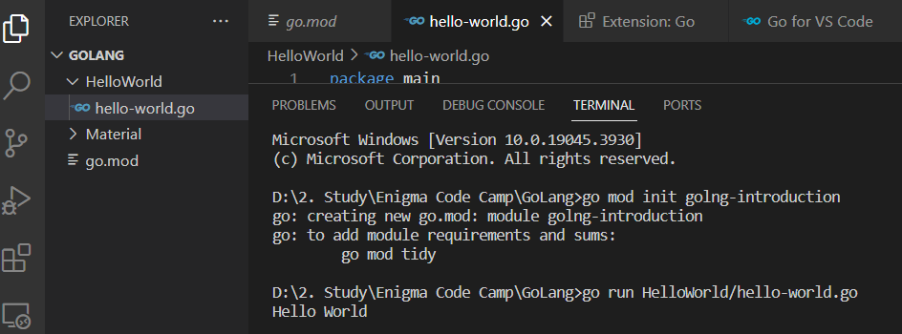
To run the app is to write the “go run file-name”
or if you wish to run the file with other files, writes “go run foldername/file-name”

